Slide 1
A Preparatory Study on and the First Analysis Steps of Systematically Considering Combinations of External Events in the Design Basis and in the PSA of NPP Paks
Tamas Siklossy, Attila Bareith, Barnabas Toth
siklossyt@nubiki.hu
IAEA Technical Meeting on Enhancement of Methods, Approaches and Tools for the Development and Application of PSA
Online - webex, September 29 – October 2, 2019

Slide 2
Content
Introduction
Overview of the publically available literature
A critical review of current Hungarian practices
Proposed technical tasks in details considering hazard combinations in the design basis and PSA
Achievements in selection and screening of external hazard combinations
Conclusions

Slide 3
Introduction
Mostly single external hazards have been considered in the definition of the design basis for the Paks NPP in Hungary
Motivation of assessing the impact of hazard combinations on NPP safety
Requirements laid down in Hungarian Nuclear Safety Codes and international recommendations
Lessons learnt from the Fukusima Dai-ichi accident
International/national R&D programs
According to a corrective measure of the PSR of the Paks NPP in 2017: a systematic survey and assessment should be performed to:
identify and characterize external hazard combinations
assess the effects of hazard combinations on NPP safety:
the adequacy of protection against hazard combinations to be included in the design basis has to be justified
the residual risk due to beyond design basis load combinations has to be quantified
The technical tasks and the schedule thereof had to be worked out first.

Slide 4
Overview of the Publically Available Literature
Hungarian regulations: NSC
International recommendations: WENRA and IAEA
Swedish Nuclear Inspectorate: SKI Report 02:27 (2003)
EPRI: Identification of External Hazards for Analysis in Probabilistic Risk Assessment (Update 2015)
Technical reports developed in the ASAMPSA_E project
A WGRISK task and the corresponding questionnaire on external hazards PSA (2007)
Technical articles on national assessments, e.g.:
GRS on screening of hazard combinations
External hazard combinations PSA for NPP Hanhikivi
Methodological documents on multivariate distribution functions

Slide 5
A Critical Review of Current Hungarian Practices – Design Basis
FSAR – targeted assessment in 2002:
no need to consider any hazard combinations in the design basis
not a state-of-the-art analysis (simplistic, have not been updated)
Assessments of single hazards included considerations to some potential hazard combinations
man-made hazards – no correlation, except for meteorological conditions
meteorology – no correlation, except for wind&snow loads on structures
Danube contamination endangering the water intake system – combination considered in the identification of relevant event sequences
hydrology – possible combinations of single hydrological events
geosciences – all seismological hazards are assessed in conjunction with geotechnical, geological and tectonic conditions and hazards
The combination among the different types of hazards was not assessed
Site investigation and evaluation program for new NPP builds (Paks 2016-2018) – targeted assessment of hazard combinations
the results cannot be applied directly to the existing NPP units without further investigations
the assessment has some inherent boundaries that should be considerd, e.g. no input data derived for PSA
need to revise and supplement quite a few analysis assumptions and evaluations

Slide 6
A Critical Review of Current Hungarian Practices – PSA
No dedicated PSA for hazard combinations for the Paks NPP
PSA for single hazards includes considerations to some potential hazard combinations
full correlation for instantaneous, daily average and weekly average air temperature and cooling water temperature
hydraulic load assessment for the canalization system – extreme precipitation & LOOP (cooling water of diesel generators)
potential snow induced blockage of air intake systems (wind&snow)
fragility of the grid due to extreme temperature (all relevant grid related events that may occur)
vulnerability of the power transmission lines to the combination of extreme wind, frost and ice formation, and high/low air temperatures
partial correlation between earthquake and soil liquefaction

Slide 7
Types of External Hazard Combinations
Combination of dependent hazards – causal connection
Consequential hazards – cause-effect relation:
A may cause B (e.g. explosion – forest fire)
A is a prerequisite of B (e.g. earthquake – soil liquefaction)
Non-consequential connected hazards (correlated hazards) – common root cause (e.g. certain meteorological conditions trigger many hazardous phenomena)
Combination of independent hazards – no causal connection
independent events have a high occurrence frequency,
at least one of the events is long-lasting and usually rare.

Slide 8
Proposed Technical Tasks
PSA:
Selection of external hazard combinations
Screening of external hazard combinations
Detailed assessment of screened-in events:
Probabilistic hazard assessment
Plant response and fragility analysis
Event logic modeling and risk quantification
Design basis (identification of hazard combinations and justification of plant protection):
Selection of external hazard combinations
Screening of external hazard combinations
Definition of design basis load combinations
Evaluation of plant protection and specification of protective measures

Slide 9
Selection of External Hazard Combinations
Development of a comprehensive list of potential single external hazards
Screening of single hazards with respect to hazard combinations
screening by relevance (cannot occur at the site)
frequency based screening (Hungary: 10⁻⁷/a for an existing NPP)
Evaluation of the dependence among the hazards
a table („matrix”) form – cross-correlation chart
for all the possible hazard combinations, the possible relation type has to be identified and marked with a predefined symbol
identification of hazard combinations including 3 or more hazards:
mapping of root causes that may trigger such combinations
studying the dependence in rows and columns of the cross-corr. chart

Slide 10
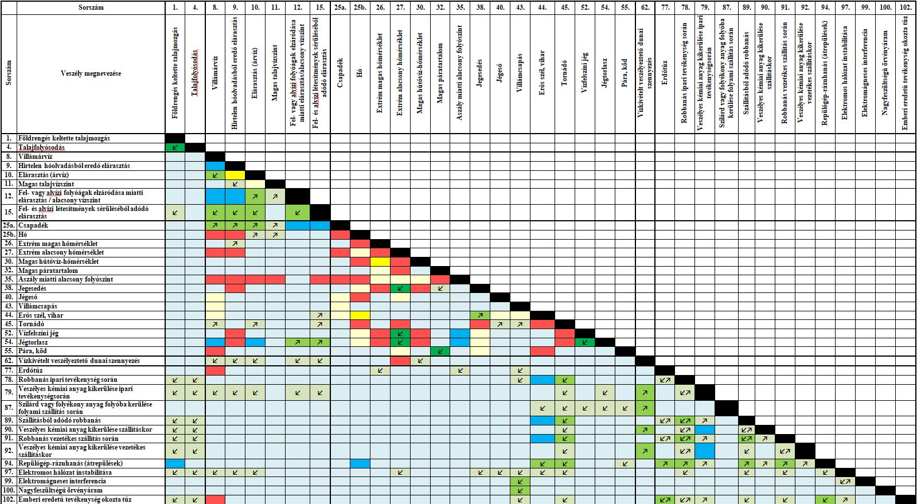

Slide 11
Selection of External Hazard Combinations – Possible relation types
↗↙ | one hazard is a prerequisite of the other hazard
↙↗ | one hazard may cause the other hazard, the impact mechanisms of the single hazards are similar or the same
↙↗ | one hazard may cause the other hazard, the impact mechanisms of the single hazards are different
 | correlated hazards, the impact mechanisms of the single hazards are similar or the same
 | correlated hazards, the impact mechanisms of the single hazards are different
 | independent hazards, the impact mechanisms of the single hazards are similar or the same
 | independent hazards, the impact mechanisms of the single hazards are different
 | mutually exclusive hazards

Slide 12
Screening of External Hazard Combinations
In general, the same screening criteria as for single hazards
Relation between the impact mechanisms of the single hazards:
similar or the same (e.g. wind & snow to structures):
hazards affect the same SSCs amplifying one another’s effects
resistance against the combined load has to be assessed
different (e.g. wind & high temperature)
hazards do not affect the same SSCs or not with the same mechanisms
Hazard combinations specific screening criteria:
hazards are mutually exclusive
definition of a single hazard incorporates the other single hazard
the impact of the hazard combination is not more severe than the effect of the more powerful hazard

Slide 13
Screened-in Combinations of External Hazards
storm: high wind and extreme precipitation and thunder
snowstorm: high wind and extreme snow
extremely high temperature conditions: extremely high air temperature and high Danube water temperature
extremely low temperature conditions: extremely low air temperature and surface ice on the Danube (and icing and snow)
earthquake and soil liquefaction
earthquake and extremely high or low air temperature (independent)
simultaneous accident in nearby industrial facilities that handle dangerous chemical substances (due to a common root cause)
extreme meteorological conditions and handling of dangerous substances (the meteorological conditions may have a significant impact on the dispersion of dangerous substances)

Slide 14
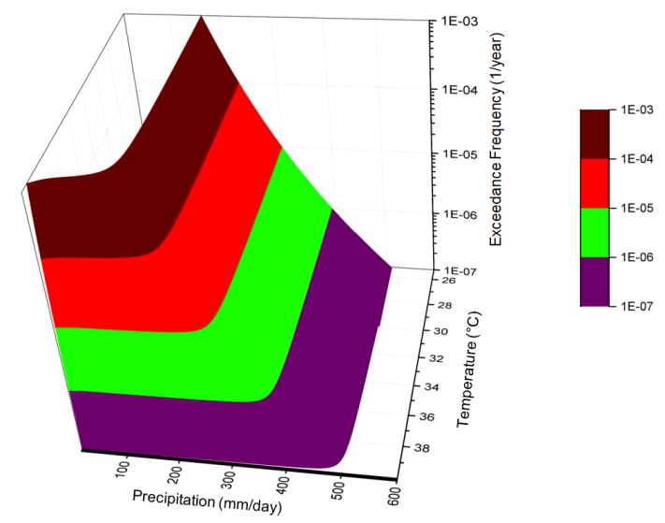
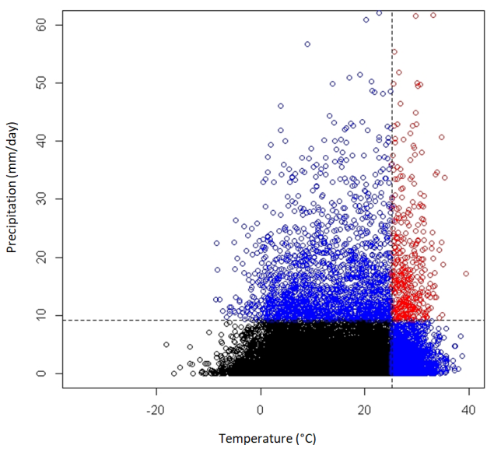
Probabilistic Hazard Assessment
Frequency-magnitude relationship for different magnitudes of load combinations
combination of dependent hazards – causal connection
consequential hazards – cause-effect relation $P_{1,2}=λ_{1}·P(2 Ι 1)$
correlated hazards – common root cause correlation has to be determined
hazard curve (surface) development, e.g. multivariate extreme value theory for meteorological hazards
current practice: hazard occurrence frequencies for predefined combinations of load intensity
combination of independent hazards (high occurrence freq. or long-lasting event)
$\int_{0}^{N}{f_{2}(y)\int_{y}^{y+t_{2}}{f_{1}(x)dxdy+}}\int_{0}^{N}{f_{1}(x)\int_{x}^{x+t_{1}}{f_{2}(y)dydx=P}}$
$P=N·λ_{1}{·λ}_{2}·\left(t_{1}+t_{2}\right)$
$λ_{i}$ occurrence frequency of event i [1/a]
$t_{i}$ duration of event i [year]
N duration (within a year) when both events can occur simultaneously [year]

Slide 15
Plant Response and Fragility Analysis, Event Logic Modeling, Risk Quantification
Plant response and fragility analysis
which SSCs are challenged and how to characterize the vulnerability
ideally: probability of failure for different levels of load combinations by means of fragility surfaces
current practice: fragility for predefined combinations of load intensity
relation between the impact mechanisms of the single hazards is decisive
Event logic modeling and risk quantification
approach is similar to that of the single hazards PSA
assessment of plant transients, degradation of mitigation systems induced by hazard combination, impact on the conditions of human interactions/responses
random SSC failures and human failure events considered too

Slide 16
Conclusions
As a preparatory step to systematically identify and assess the combinations of external hazards for the Paks NPP:
the regulations and recommendations have been thorougly reviewed
the available methodologies have been studied and evaluated
analysis practices applied in Hungary have been examined
a proposal has been developed for the technical tasks and the schedule thereof to identify combinations of external hazards and assess the effects of such hazards on NPP safety
The assessment of external hazard combinations has been started in 2019 and is planned to be finished in 2022.
Selection and screening of external hazard combinations performed

Slide 17
Thank you for your attention!

